Slide 1
CSCI 598 – Professional Writing and Communication for Computer Scientists
Class 1
Steve Bucher – sbucher@usc.edu
Steve Schrader – sschrade@usc.edu

Slide 2
<!DOCTYPE html>
<html lang="en" id="www-usc-edu">
<head>
<meta charset="utf-8">
<meta name="Keywords" content="usc, southern cal, southern california, trojans, los angeles, socal, private university, research university, uscweb, uscnet, usc.edu">
<meta name="Description" content="The University of Southern California is one of the world's leading private research universities, located in the heart of Los Angeles. ">
<meta name="google-site-verification" content="7jISKLgSY6Xj9zt1ZjvoVsHZvOMpGjgzih8xn6sDoXA">
<title>University of Southern California</title>
<!--favicon & live bookmark-->
<link rel="icon" href="favicon.ico">
<link rel="apple-touch-icon" href="http://www.usc.edu/x/usc_homepage/assets/images/apple-touch-icon.png">
<link rel="alternate" type="application/rss+xml" title="RSS" href="http://uscnews.usc.edu/feeds/main.xml">
<!--CSS-->
<link rel="stylesheet" href="/x/usc_homepage/assets/css/usc.css" media="screen, projection">
<!--[if lt IE 9]>
<script src="http://html5shim.googlecode.com/svn/trunk/html5.js"></script>
<![endif]-->
<!--[if IE]>
<link rel="stylesheet" href="/x/usc_homepage/assets/css/ie.css?v=6" media="screen, projection">
<![endif]-->
<!--[if lt IE 7]>
<link rel="stylesheet" href="/x/usc_homepage/assets/css/ie6.css?v=5" media="screen, projection">
<![endif]-->
<script>

Slide 3
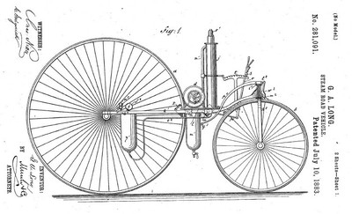

Slide 4
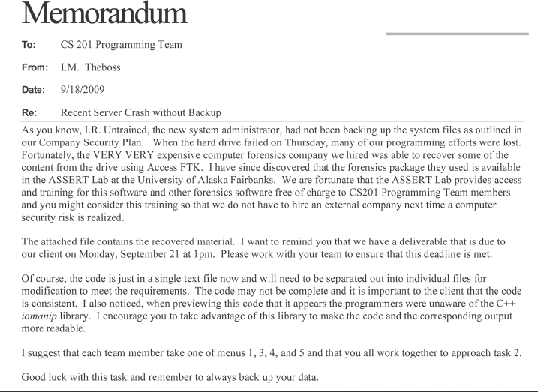

Slide 5
Two Myths of Engineering Communication
Engineers Have No Need to Communicate Effectively
Workplace Realities
Interdisciplinary Realities
International Demands
Engineers are Incapable of Communicating Effectively

Slide 6
Results of Bad Communication
1907 Quebec Bridge
Correspondence was 3 Weeks Too Late
Walkway at Kansas City Regency
Design Standards Poorly Communicated
Mars Climate Orbiter
Imperial Units vs. Metric Units
Space Shuttle Challenger
Miscommunication between NASA Management and Engineers
Ordinary Business Failures
Career Setbacks

Slide 7
Communication Goal
To have what you write or say be understood and remembered

Slide 8
Communication Goal
To have what you write or say be understood and remembered
“Mars Rover engine should fire at 3 ft.”
“Control indicators are red, blue, and green”
“Provide Overhead Data from Last Project in Section 12.4.1”
“Let’s take care of it.”

Slide 9
Factors
Anything that contributes to or detracts from the effectiveness of the communication process
Communicating to the Situation
Ex. This Lecture
Your POV
My POV

Slide 10
Course Overview
Goal
Syllabus
Posted
Assignment Schedule
Topic Schedule
Assignments will Build on Each Other
Writing Sample
Three papers
Two presentations
http://courses.uscden.net

Slide 11
Course Overview
Processes
Lecture
Discussion
Readings
Attendance and Participation
Submissions and Feedback
Presentations
To an Audience
Friday and Saturday Slots

Slide 12
Course Overview
Assignment Submission – Dropbox
“Statement of Originality”
Turnitin
Grading Cohorts
Formats, Templates Provided When Required
70% Threshold

Slide 13
Course Overview
Each assignment’s factors defined
“Sprint-like” approach
Two-week Turnaround
Goals
Criteria for success
Content
Organization
Audience
“Stand up meetings”

Slide 14
Course Overview
What the Course is Not:
Grammar Class
Accent Reduction

Slide 15
Communication Defined
“Communication is a process by which information is exchanged through both verbal and non-verbal means.”

Slide 16
Communication Defined
“Communication is a process by which information is exchanged through both verbal and non-verbal means.”

Slide 17
Basic Steps of Communication
Sender has an idea
Idea becomes a message (encoding)
Message is transmitted (channel)
Message is received
Receiver reacts and sends feedback

Slide 18
Basic Steps of Communication
Sender has an idea
Idea becomes a message (encoding)
Message is transmitted (channel)
Message is received
Receiver reacts and sends feedback
“The Medium is the Message”
A Love Letter
A Business Letter vs Fax
A Speech vs a Presentation

Slide 19
Communication Defined
“Communication is a process by which information is exchanged through both verbal and non-verbal means.”

Slide 20
Information
Anything that imparts knowledge.
Examples??

Slide 21
Information
Words
Pictures
Actions
Order
Timeliness
Style/Format (paragraph length, bullets, numbers)
Authority
Tone/Emphasis (“I don’t know.”)

Slide 22
Communication Defined
“Communication is a process by which information is exchanged through both verbal and non-verbal means.”

Slide 23
Exchange of Information
Value as a listener
Never passive
Value as a reader

Slide 24
Communication Defined
“Communication is a process by which information is exchanged through both verbal and non-verbal means.”

Slide 25
Verbal and Non-Verbal
Scroll vs. Email
Letter vs. Fax
Page vs. Screen

Slide 26
Verbal and Non-Verbal
Point A, Point B, and Point C
vs
Point A
Point B
Point C
vs
Point A
Point B
Point C

Slide 27
Verbal and Non-Verbal
In my opinion workplace monitoring is very essential to maintain a healthy work culture and our company is making proper use of it. It is using the analysis in favour of the employees. Google should continue with this method as clearly it is being advantageous to the company and the employees but we should be careful when it comes to personal privacy. I think Google can hold various sessions to make the employees aware of its workplace monitoring policy and how it can be trusted easily. They should be aware that their data is not being used for any wrong means. They should also know what they can or cannot access in workplaces. There should be a clear definition of the ethical policy and what data can raise a red flag. Also employees should be made aware of the importance of keeping the personal data separate. They should be aware of their right to privacy and how they can separate their private data and save it from being monitored. A company cannot work without employees and employees need a company. Both entities go hand in hand. Proper understanding of the system can help the employees and the company, together in achieving greater heights.

Slide 28
Verbal and Non-Verbal
In my opinion workplace monitoring is very essential to maintain a healthy work culture and our company is making proper use of it. It is using the analysis in favour of the employees. Google should:
Continue with this method as clearly it is being advantageous to the company and the employees but we should be careful when it comes to personal privacy.
Hold various sessions to make the employees aware of its workplace monitoring policy and how it can be trusted easily. They should be aware that their data is not being used for any wrong means. They should also know what they can or cannot access in workplaces.
There should be a clear definition of the ethical policy and what data can raise a red flag. Employees should be made aware of the importance of keeping the personal data separate. They should be aware of their right to privacy and how they can separate their private data and save it from being monitored.
A company cannot work without employees and employees need a company. Both entities go hand in hand. Proper understanding of the system can help the employees and the company, together in achieving greater heights.

Slide 29
Verbal and Non-Verbal
Eye Contact
Body Movement
Gestures
Tone/Inflection
Culturally Specific

Slide 30
Barriers to Communication
Information overload
Wrong medium
Not knowing audience
Jargon
Inappropriate style
Bad first impression
Timeliness

Slide 31
To Improve Communication…
Knowledge and Preparation
Drafts
Rehearsal

Slide 32
Writing Sample
Prompt on course site
Submit via Dropbox
Include “Statement of Originality”

Slide 33
Writing Sample
Describe a time you communicated badly.
One page
Incident
Implications
Results
Use memo format

Slide 34
For Next Week
Writing Sample (by start of class on Jan. 20)
Tebeaux, Chapters 1 and 2
Brereton, Chapter 1

